Slide 1
FREELANCE JOB APP
Lavin Valechha
D15B
70

Slide 2




INTRODUCTION
Purpose: The freelance job application serves as a platform for connecting freelancers with potential projects, facilitating job postings, communication, and collaboration.
Shift in Work Culture: The global workforce is increasingly embracing freelancing as a viable career option, driving the need for efficient platforms to connect freelancers with employers.
Global Connectivity: With the rise of digital platforms, freelance job applications facilitate connections between talent and businesses worldwide, transcending geographical barriers.
Adaptation to Changing Needs: As traditional employment models evolve, freelance job applications offer a dynamic solution that aligns with the changing needs of both workers and employers.
Grow Reporting

Slide 3



OBJECTIVES:
Create a Platform for Freelancers and Clients: Develop a platform where freelancers can showcase their skills and clients can post job opportunities.
Facilitate Job Posting and Application: Implement features for clients to easily post job listings.
Efficient Communication: Enable seamless communication between clients and freelancers through commenting or email within the app.

Slide 4

TECH STACK
Flutter
FireBase

Slide 5

FEATURES:
Job Posting: Users can post job listings detailing project requirements, skills needed, and compensation offered. This feature allows employers to find suitable candidates efficiently.
Commenting System: A commenting system allows users to leave feedback, ask questions, or provide additional details regarding job listings. This enhances communication and fosters transparency between employers and freelancers.
Multipurpose Functionality: Freelance job applications offer multipurpose features, allowing users to post job ads, send inquiries.

Slide 6
FEATURES:
Email Communication: Integrated email functionality enables seamless communication between employers and freelancers. This feature streamlines the hiring process and ensures effective collaboration.
Clean Layout: Maintain a clean and clutter-free layout with well-defined sections, ample white space, and consistent design elements to enhance readability and visual appeal.

Slide 7


IMPLEMENTATION

Slide 8
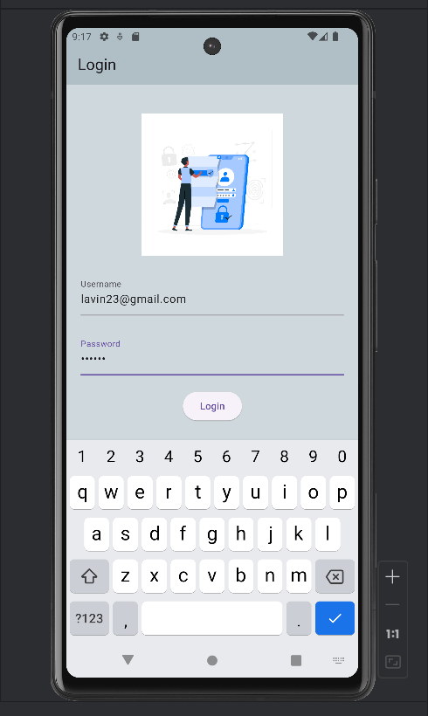
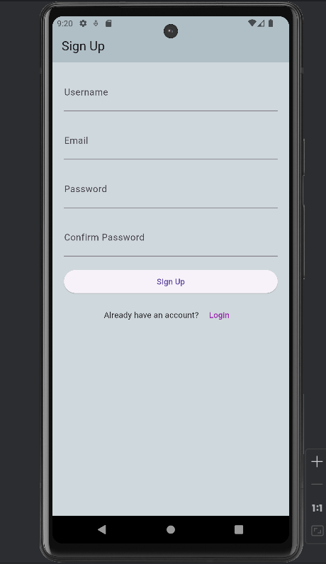
Registration and Login

Slide 9
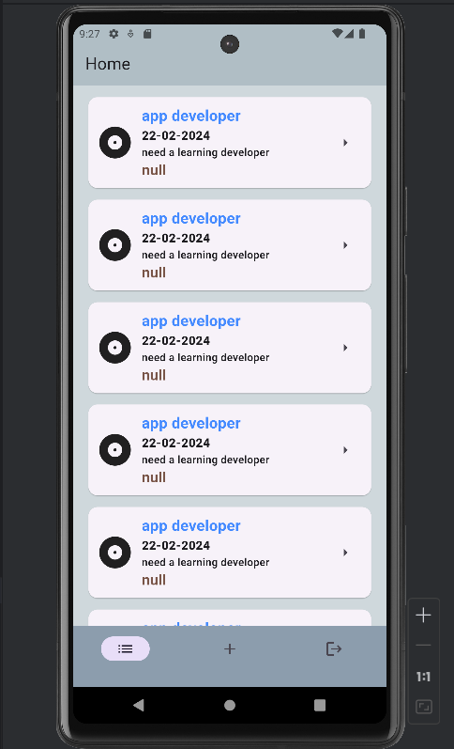
Home Dashboard: It consists all the listings

Slide 10
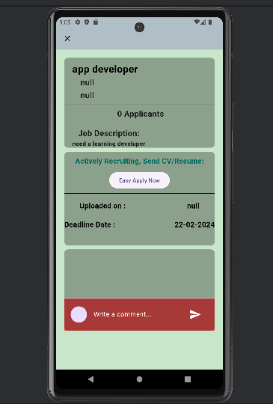
Particular listing: This is particular listing where user can comment “interested, write their email id, contact or anything to connect”.
Or they can directly email the the person who listed the job.

Slide 11
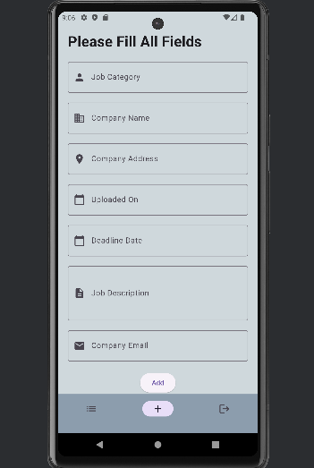
Upload feature: This is where the user can list the job and fill in all the details regarding the project.
It includes Job category.

Slide 12

FUTURE SCOPE:
Multilingual Support: Expand language options to accommodate diverse users, fostering inclusivity and broader adoption.
Enhanced Filter: Implement advanced Filter feature based on user preferences, skills, and project requirements to improve the accuracy of job recommendations and freelancer suggestions.
Expansion of Services: Expand the range of services offered on the platform beyond traditional freelance jobs to include additional categories such as online courses, consulting services, mentorship programs, and collaborative projects.

Slide 13
CONCLUSION:
In conclusion, the Freelance Job Application developed using Flutter offers a comprehensive solution for both freelancers and employers, facilitating seamless communication and task management.
The application's multipurpose nature ensures adaptability to various user needs, while its organized UI enhances user experience.
Overall, the Freelance Job Application presents a promising platform for efficient freelancing and hiring, contributing to the gig economy's growth and facilitating productive collaborations.

Slide 14
PROGRESSIVE WEB APP

Slide 15
INTRODUCTION
Cross-Platform Compatibility: PWAs work seamlessly across various devices and platforms, reducing the need for separate development efforts for different operating systems.
Improved User Experience: They offer fast loading times, offline access, and smooth navigation, enhancing user satisfaction and engagement.
Cost-Efficiency and Accessibility: Developing a PWA involves lower costs compared to native apps, and their accessibility via URLs eliminates the need for app store downloads, making them more convenient for users.

Slide 16
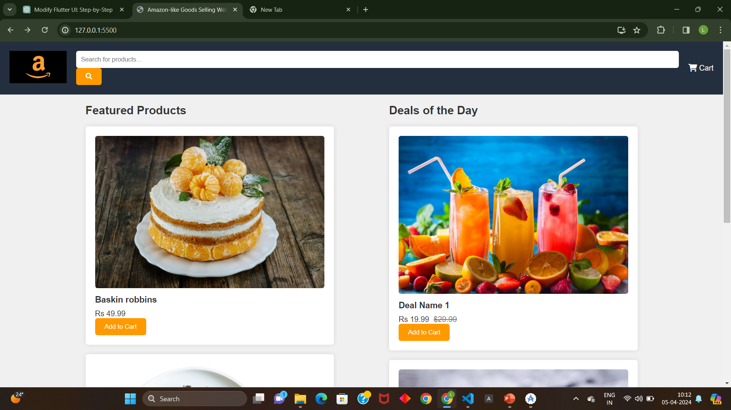
IMPLEMENTATION:

Slide 17
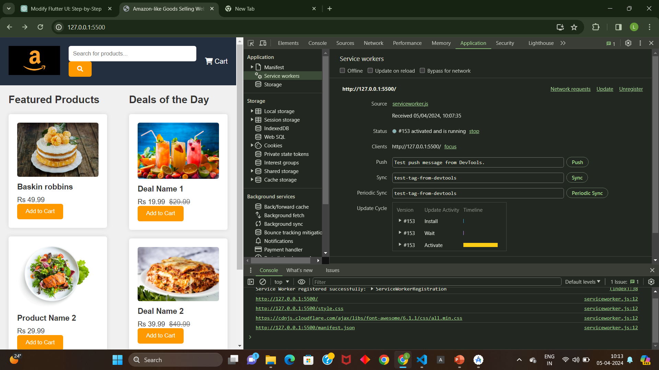
IMPLEMENTATION:

Slide 18
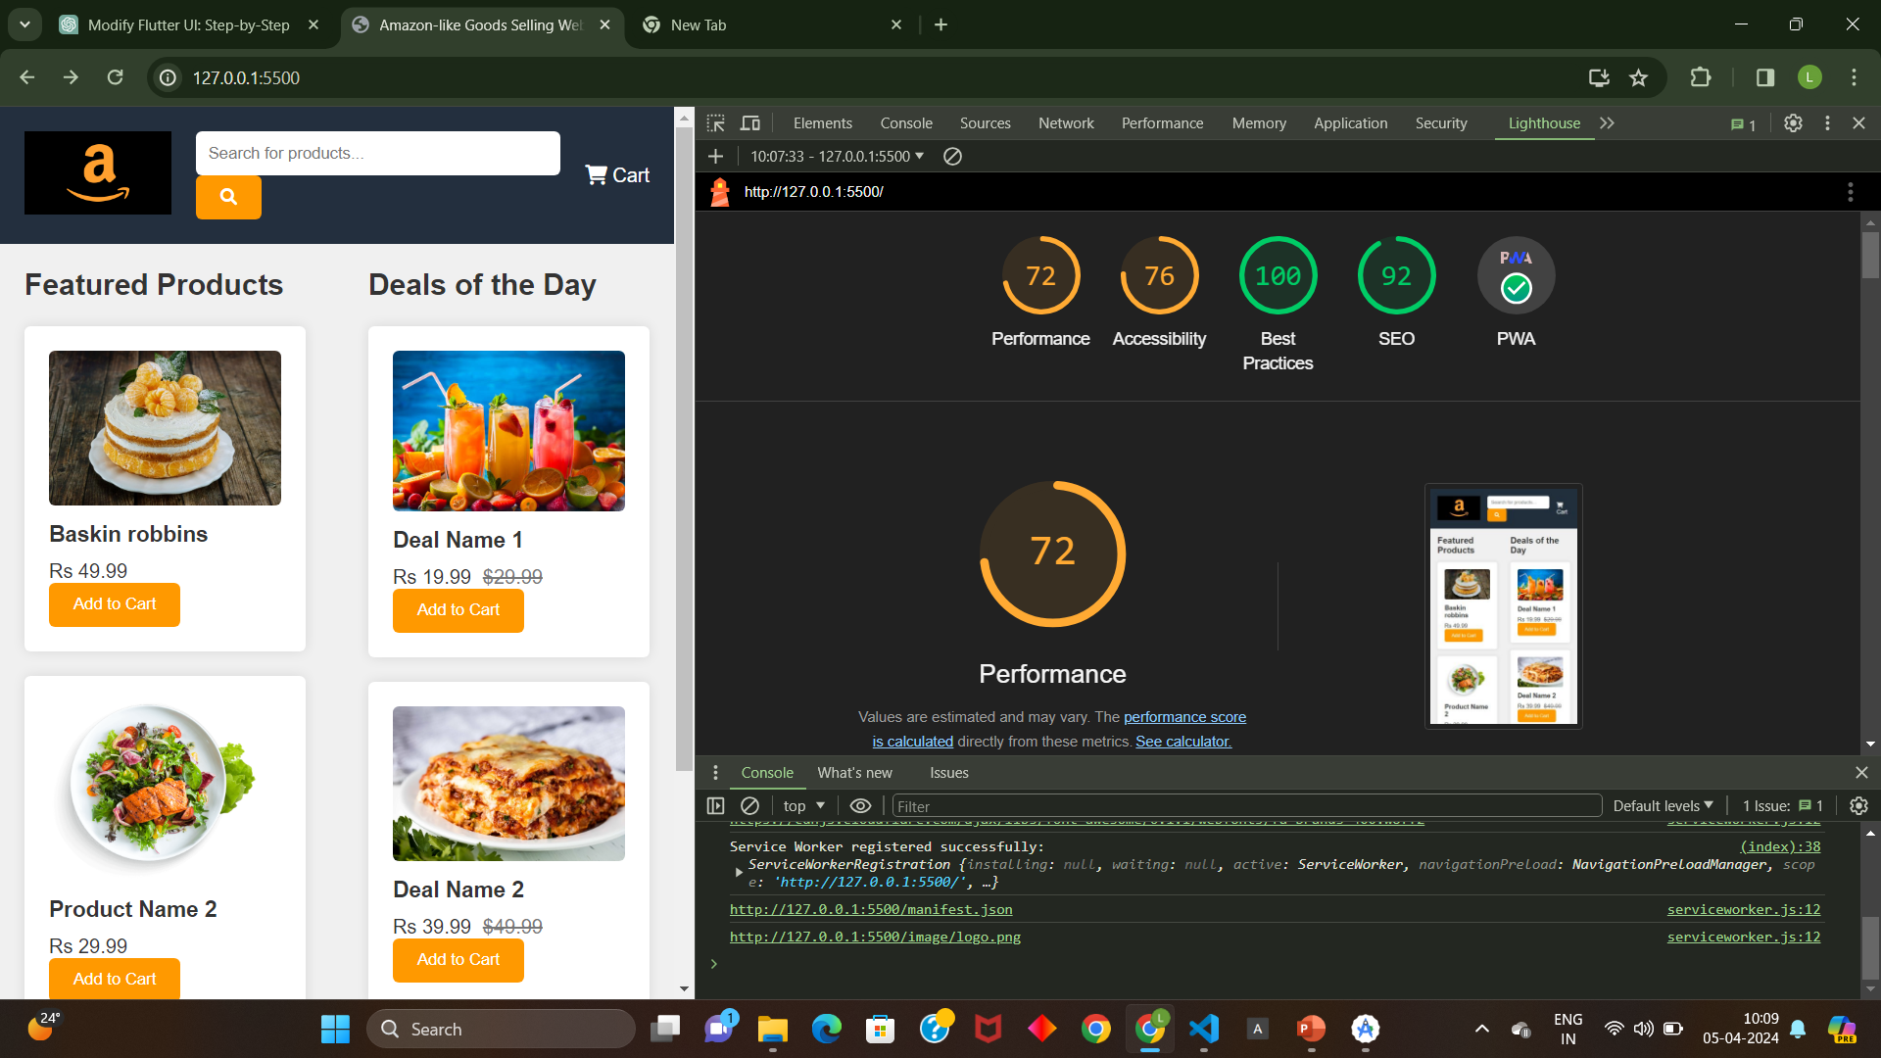
IMPLEMENTATION:

Slide 19

KEY FEATURES:
Push Notifications: PWAs can send push notifications to users, enhancing engagement by delivering timely updates and alerts.
Background Sync: With background sync events, PWAs can synchronize data in the background, ensuring seamless user experiences even in intermittent connectivity scenarios.
Offline Functionality: PWAs utilize service workers to cache content, enabling users to access and interact with the app even when offline, thereby ensuring uninterrupted usage.
App-like Experience: PWAs can be installed on the user's device and offer features such as home screen icons and full- screen mode, providing an app-like experience without the need for traditional app store distribution.

Slide 20
CONCLUSION:
PWAs offer significant benefits for ecommerce by providing a fast, engaging, and reliable shopping experience.
With features like offline functionality, push notifications, and background sync, PWAs ensure that customers can browse products, make purchases, and receive updates seamlessly, even in low connectivity situations.
Moreover, their cross-platform compatibility and ease of access without app store downloads make PWAs an ideal solution for ecommerce businesses seeking to reach a wider audience and drive increased sales.

Slide 21
THANK YOU

